Slide 1
Excelerate Students Data Analysis
RIT 1410 AI Team 5A

Slide 2
Overview
Introduction
Exploratory Data Analysis (EDA)
Insight Generation
Hypothesis Development
Churn Analysis
Predictive Modeling
Recommendations
Conclusion

Slide 3
Team Members
Team Member Name | Email ID
Abdullah Imran | abdullahimranarshad@gmail.com
Krishin Tharani | Krishintharani1+internships@gmail.com
Emani Likhita | likhi.m9363@gmail.com
Sangeeta Sahoo | sahoo1107.sangeeta02@gmail.com
Matthew Ojo | ojoaisosamatthew@gmail.com
John syllah | johnsyllah2003@gmail.com
Tracy Reson | tracyreson@gmail.com
Afra Falakh | afrafalakh16@gmail.com

Slide 4
Introduction

Slide 5
1.1: Understanding the Dataset
The dataset originally had 8,559 rows and 33 columns.
This dataset is related to the Students who had participated in one of the internship programs powered by Excelerate, back in June 2023.

Slide 6
1.2: Key Challenges in the Dataset
Dataset had a lot of empty cells.
It had number of columns with a wrong data type that could have caused issues down the line.
Dataset had not been analyzed for insights extraction.

Slide 7
2. Exploratory Data Analysis (EDA)

Slide 8
2.1: Initial Data Cleaning

Slide 9
2.1: Initial Data Cleaning
Changing the data types of the columns to appropriate format
Date to be in datetime64[ns] format, Zip code to be int, etc.
Dropping the columns that had a lot of empty data or were of no use
Validating the data as per the column type, e.g.
Ensuring name is alphabetical and has at least 3 characters
Ensuring Zip Code is numerical
No extra characters such as quotation marks ‘’

Slide 10
2.2: Context Based EDA

Slide 11
2.2: Context based EDA
Ensuring that no column had any empty values
Numerizing the columns for Machine Learning models
Dropping the columns with a lot of empty data
Dropping the columns that made no sense for the model development phase
Creating new columns based on the previous columns just before the model development phases.

Slide 12
2.3: Feature Engineering

Slide 13
2.3.1: Creating new features
Creating new features:
Creating a new column “Age of Learner” based on “Date of Birth”
Creating a new column “Engagement Duration” based on the calculation between the “Apply Date” and “Starting Date”

Slide 14
2.3.2: Data Normalization
Applying FeatureHasher on First & Last Names, location, institution name, and current major.
Applying MinMaxScaler() on 'Engagement Score', 'Opportunity Participation Count', 'Days Since Last Engagement', 'Age of Learner', 'Engagement Duration'.
Applying one-hot encoding on the other columns.

Slide 15
2.3.3: Other Feature Engineering Processes
Extracting Date based features, i.e., SignUp Month & Year
Calculating Engagement Score based on “Time in Opportunity” and “Age of Learner”
Calculating “Time in Opportunity” in days based on Opportunity Start and End dates.
Adding a new column “Time Since Last Engagement”

Slide 16
3. Insight Generation

Slide 17
3.1: Simple Insight Generation

Slide 18
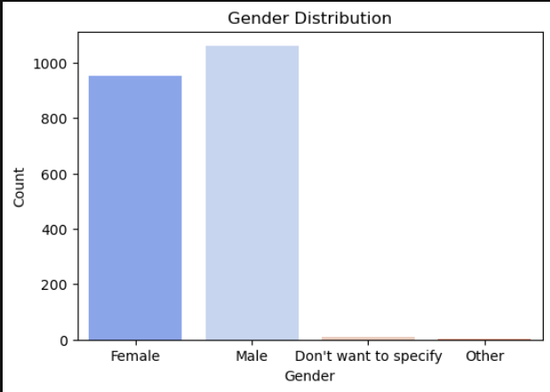
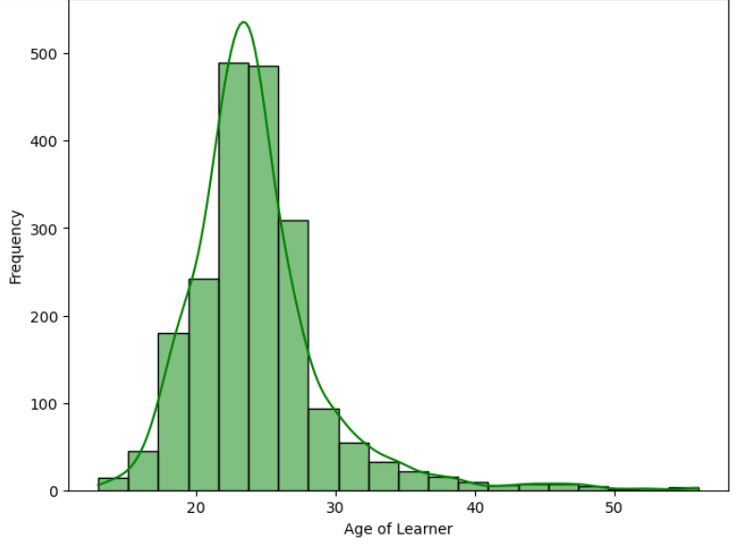
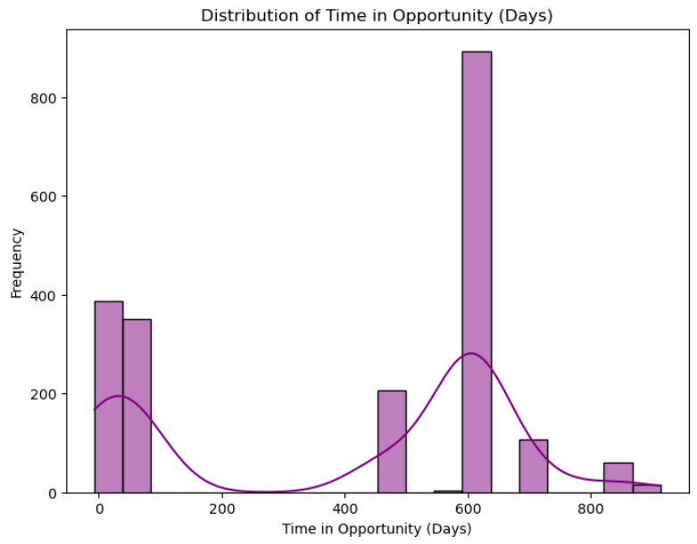
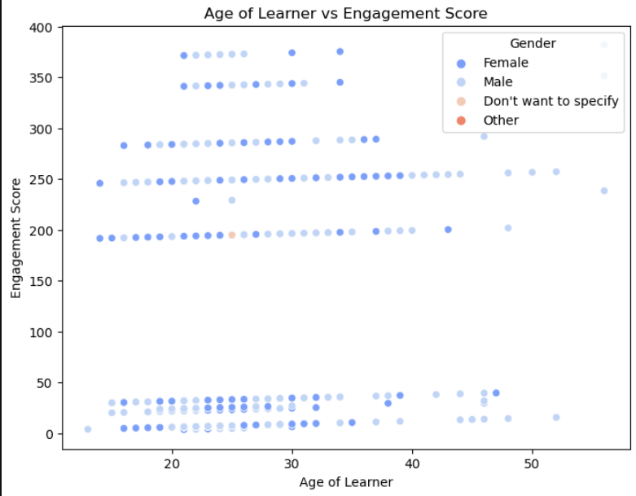

Slide 19
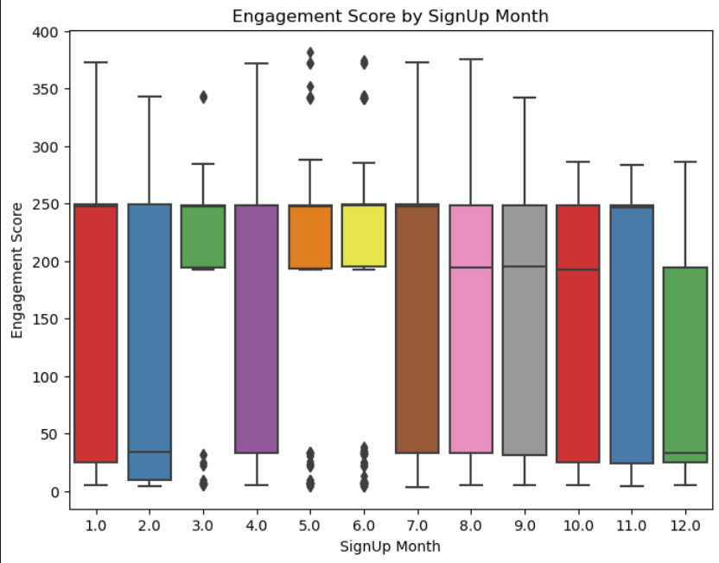
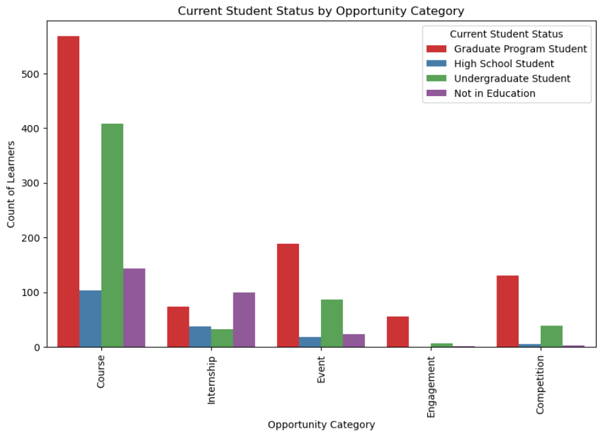
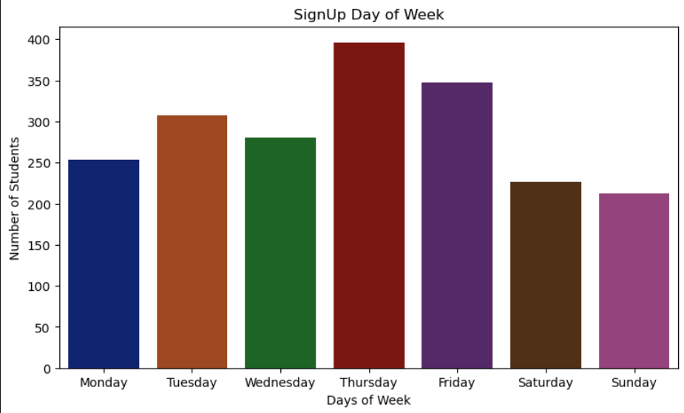
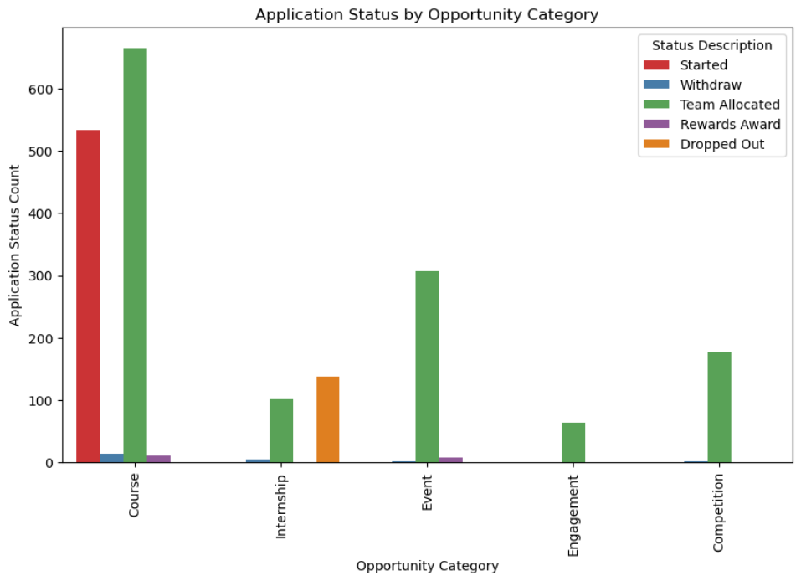

Slide 20
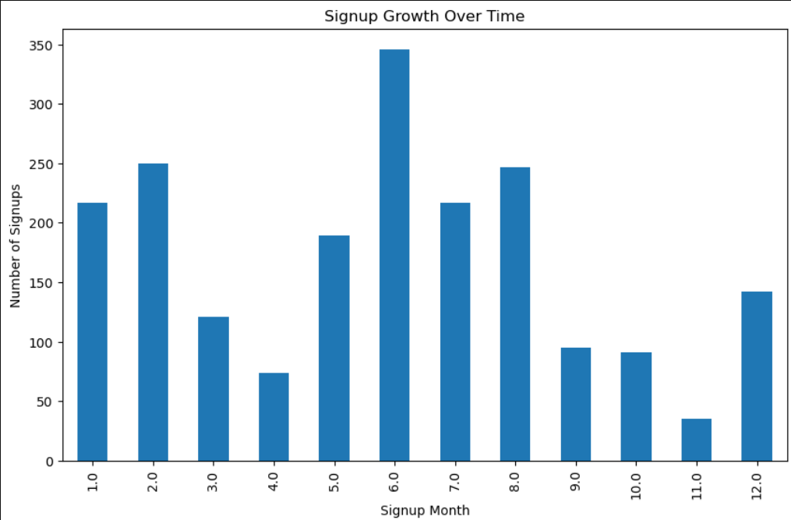
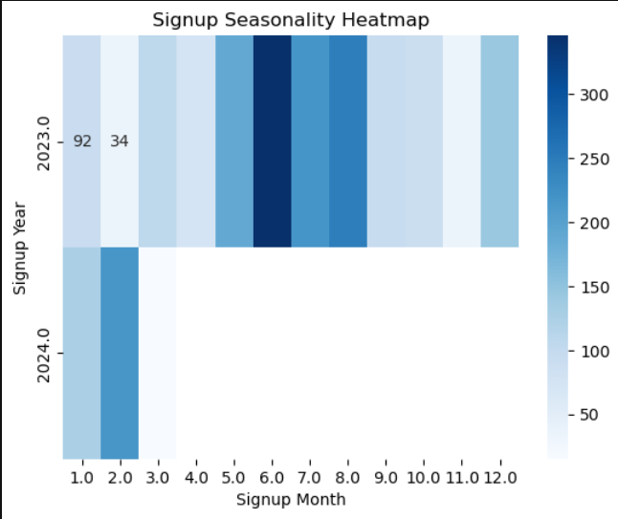
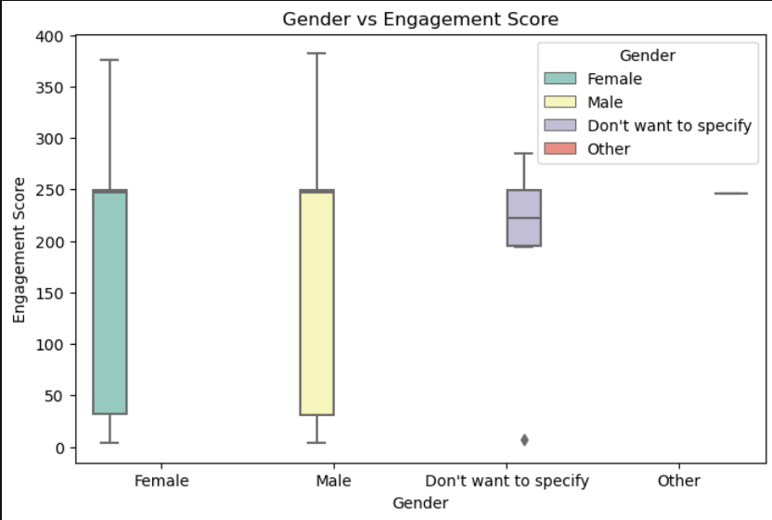
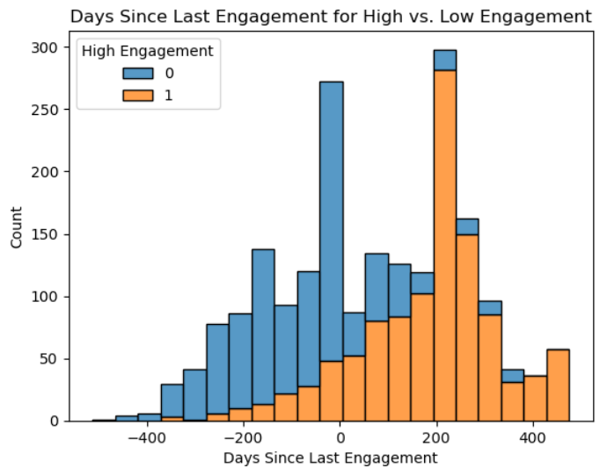

Slide 21
3.2: Advanced Insights Generation

Slide 22
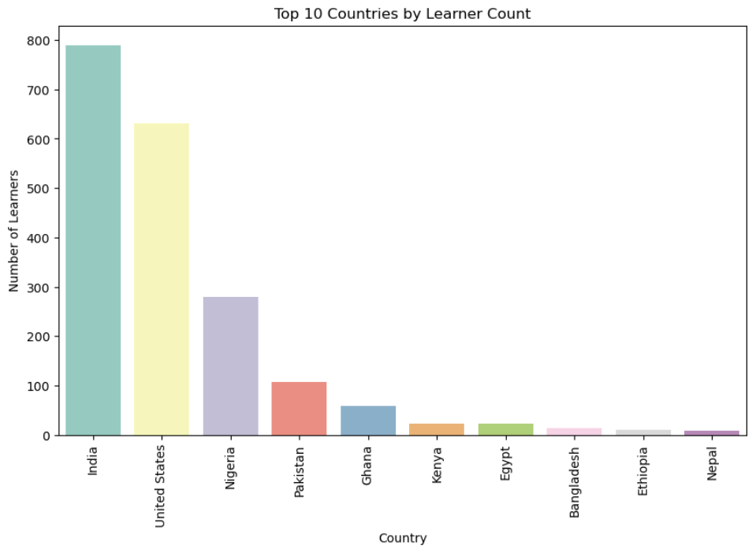
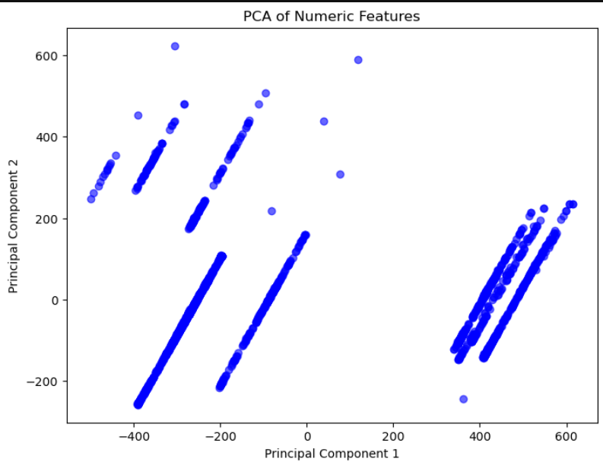
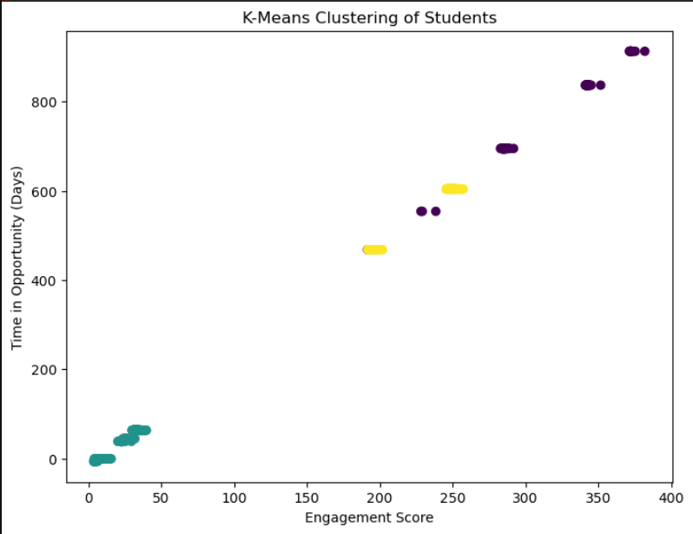
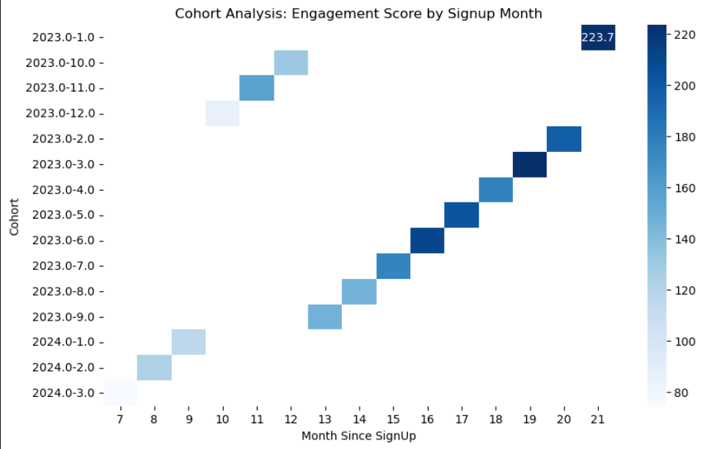

Slide 23
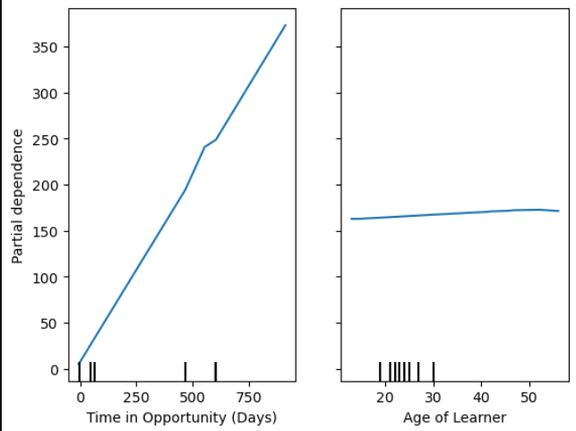
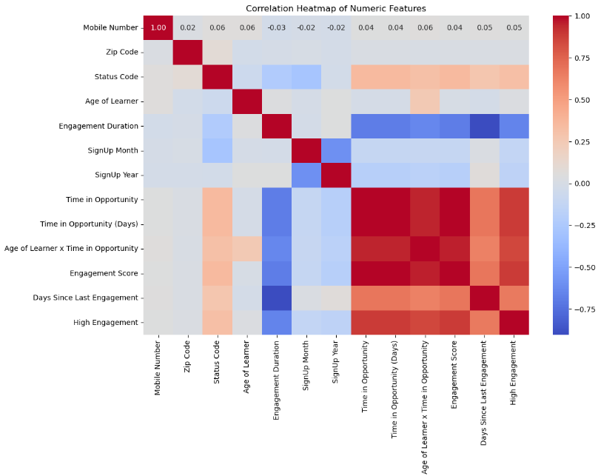
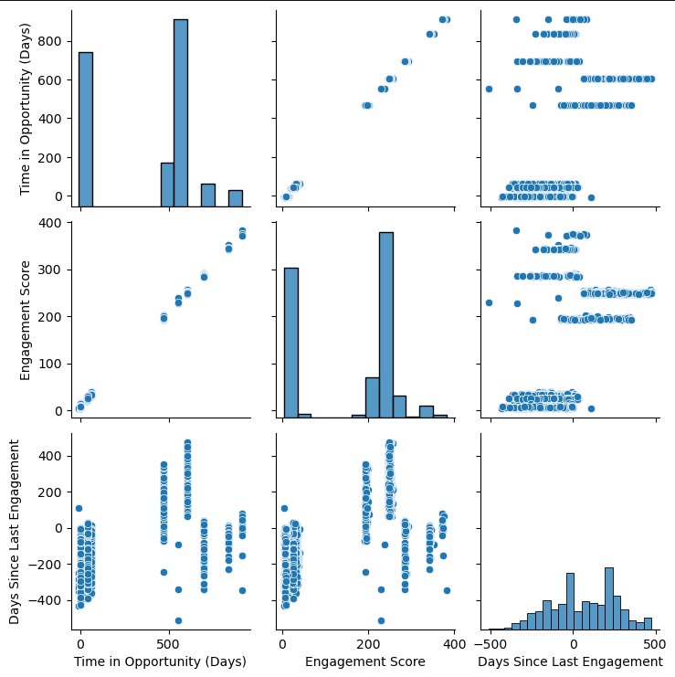

Slide 24
4. Hypothesis Development

Slide 25
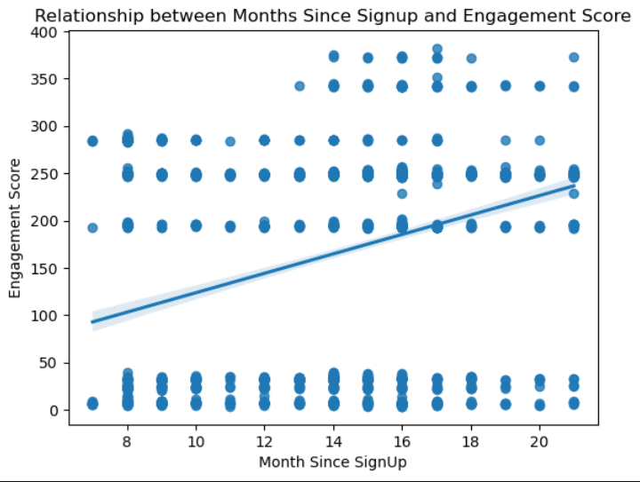
4.1: Correlation Analysis
Engagement Scores declines as the time since signup increases
Correlation of 0.33
Does not support the hypothesis

Slide 26
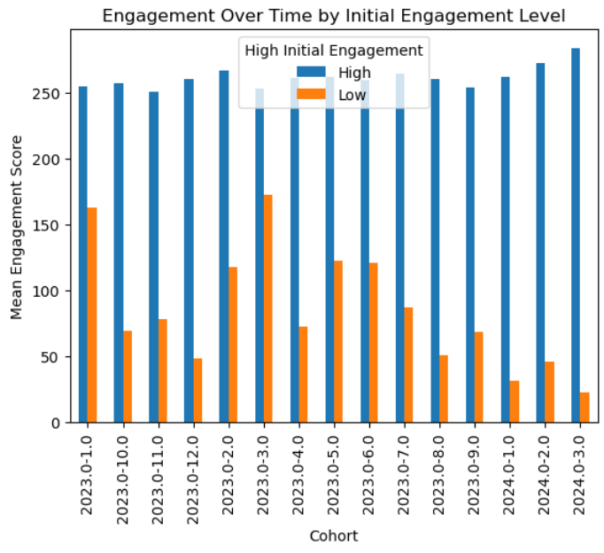
4.2: Cohort Analysis
Students who are highly engaged in the first 30 days are more likely to remain active long-term.
Supports the hypothesis.

Slide 27
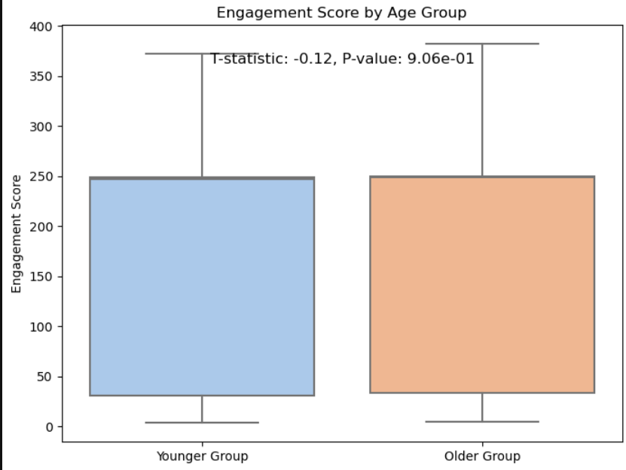
4.3: T-Test for Age Groups
Older students have higher engagement scores than younger students.
T-statistic: -0.1182, P-value: 0.9059
Does not support hypothesis

Slide 28
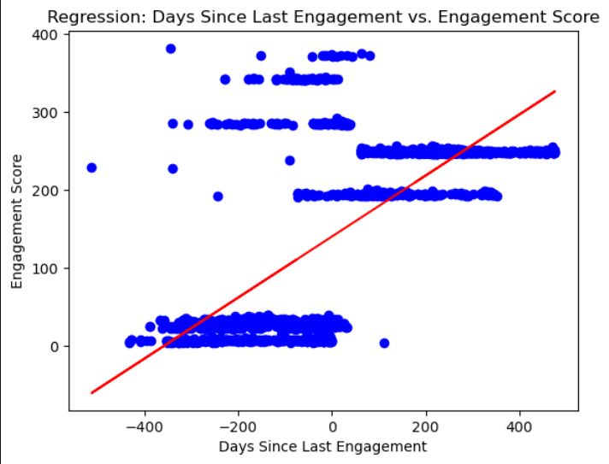
4.4: Regression Analysis
Students who have engaged recently have higher overall engagement scores.
Upward slope of the graph indicates that this supports the hypothesis.

Slide 29
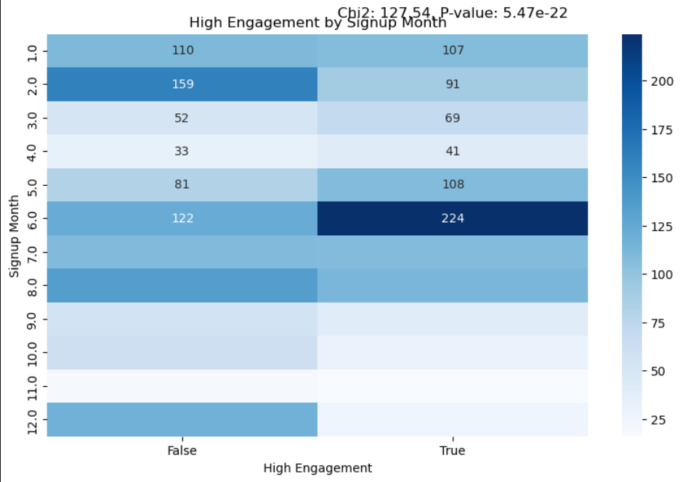
4.5: Chi-Square Test
Students who sign up early in the year have higher long-term engagement.
Chi2: 127.542, P-value:5.46652228690605 × 10 ^ (-22)
Supports hypothesis

Slide 30
5. Churn Analysis

Slide 31
5. Churn Analysis
Performed Churn analysis using the columns:
Engagement Score: Score below 2.112069
Days Since Last Engagement: Days more than 126
Opportunity Participation Count: Count less than 2
Calculated through limiting the last 25% values in each column
878 Churn out of 2195; 40% Churn Rate

Slide 32
6. Predictive Modeling

Slide 33
6.1: Machine Learning Models

Slide 34
6.1: Models
Following models were used of Machine Learning:
Logistic Regression
Decision Trees
Support Vector Machines (SVMs) – Linear Kernel
K- Nearest Neighbor (metric: euclidean)
Random Forest
Library used: Scikit-Learn

Slide 35
6.2: Deep Learning Models

Slide 36
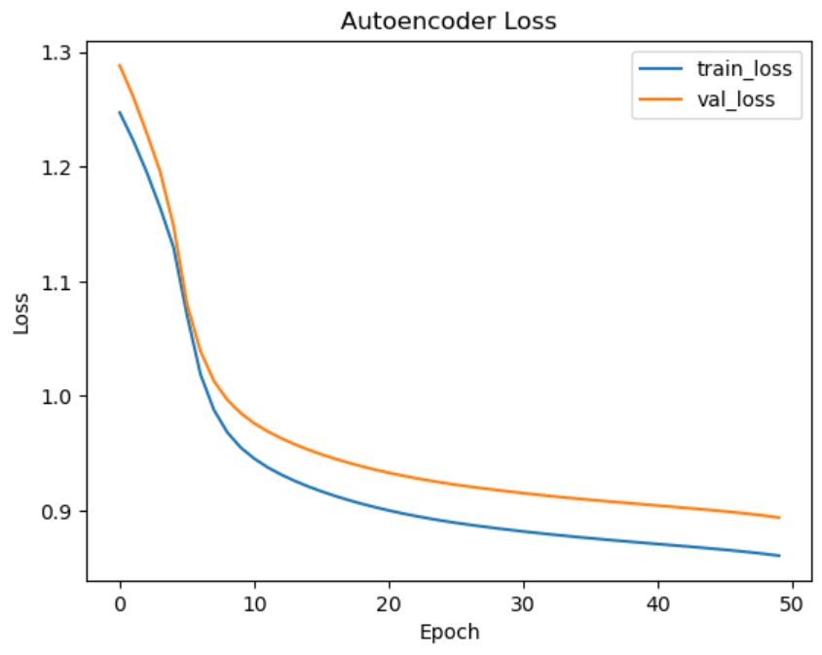
6.2: Models
Artificial Neural Network (ANN)
Recurrent Neural Network (RNN)
Autoencoder
Multilayer Perceptron (MLP)
Library used: TensorFlow, Keras

Slide 37
6.3: Evaluation

Slide 38
6.3: How did we evaluate the models?
Evaluating using confusion matrix, accuracy, precision, recall, and F1-Score.
Applied Dropout layers to avoid overfitting in deep learning models.
Evaluated against the test data to ensure the model accuracy.
In the end, got an accuracy of 1.0 for all models due to proper data cleaning and validation.

Slide 39
7. Recommendations

Slide 40
7. Recommendations
Personalized Re-Engagement Alerts: Notify students with low engagement or long inactivity to re-engage.
Targeted Course Suggestions: Recommend courses and opportunities based on student interests and participation history.
Incentivize Participation: Encourage involvement through rewards for completing activities or courses.

Slide 41
8. Conclusion

Slide 42
8. Conclusion
Thoroughly cleaned and analyzed the data using best possible data analysis and statistical techniques.
Developed models to predict the churning behavior and used best approaches during model development phases.
Based on the analysis, we gave suitable recommendations to Excelerate to reduce the churn behavior of their students.

Slide 43
Thank You

